Slide 1
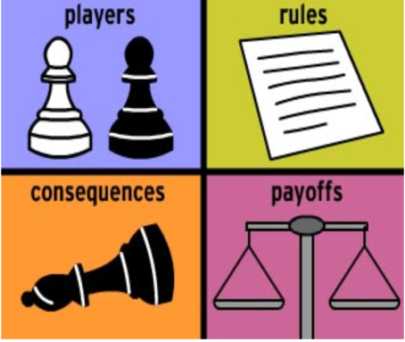
Game Theory Five
From
Mathematical Optimization and Economic Theory
Jacob Wyngaard

Slide 2
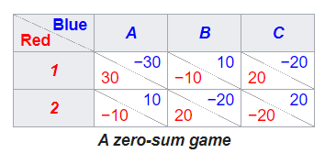


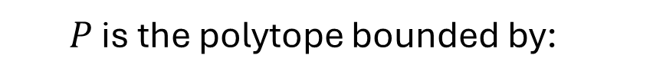

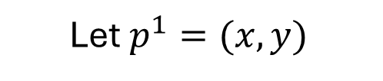


Combinatorial Vertex Enumeration
Let’s go back to this example:
$$P=\left\{p^{1}∈ℝ^{m} \right| {(Π^{2})}^{T}p^{1}≤1, p^{1}≥0\}$$
20
Let $p^{1}=(x,y)$
30
3
6
-10
-2
-20
$P$ is the polytope bounded by:
-10
-4
20
5
4
$$6x−4y ≤1$$
$$−2x+5y≤1$$
$$3x+4y ≤1$$
$$x ≥0$$
$$y ≥0$$

Slide 3





















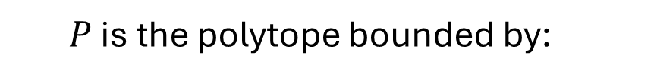




Combinatorial Vertex Enumeration
Since our probability vector $p^{1}$ lives in $ℝ^{n}$, we select two constraints at a time to make strict and solve
$$x=9/22$$
$$x=0$$
$$y=4/11$$
$$y=1/5$$
$P$ is the polytope bounded by:
$$x=2/9$$
$$x=−1/2$$
$$6x−4y ≤1$$
$$y=1/12$$
$$y=0$$
$$−2x+5y≤1$$
$$x=0$$
$$x=0$$
$$3x+4y ≤1$$
$$y=−1/4$$
$$y=1/4$$
$$x ≥0$$
$$x=1/6$$
$$x=1/3$$
$$y ≥0$$
$$y=0$$
$$y=0$$
Eliminate Vertices That Violate Constraints
$$x=1/23$$
$$x=0$$
$$y=5/23$$
$$y=0$$

Slide 4
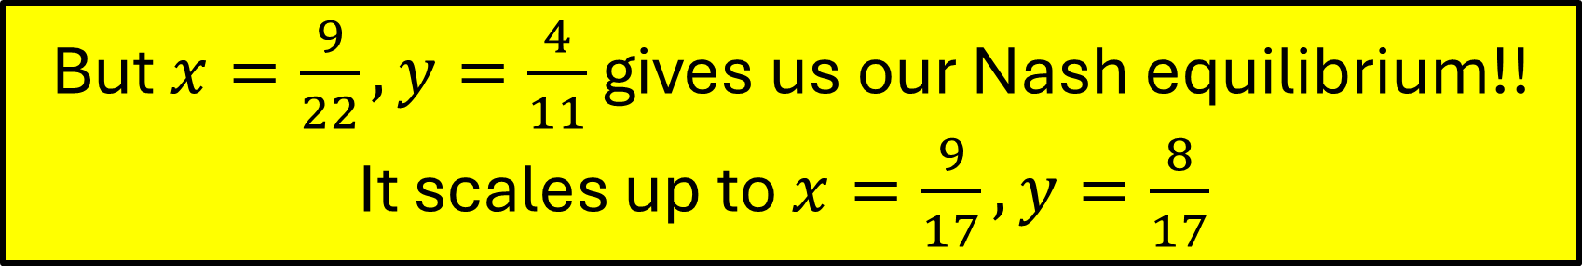
Combinatorial Vertex Enumeration
Since our probability vector $p^{1}$ lives in $ℝ^{n}$, we select two constraints at a time to make strict and solve
$$x=9/22$$
$$x=0$$
$$y=4/11$$
$$y=1/5$$
$P$ is the polytope bounded by:
$$x=2/9$$
$$x=−1/2$$
$$6x−4y ≤1$$
$$y=1/12$$
$$y=0$$
$$−2x+5y≤1$$
$$x=0$$
$$x=0$$
But $x=\frac{9}{22},y=\frac{4}{11}$gives us our Nash equilibrium!!
It scales up to $x=\frac{9}{17},y=\frac{8}{17}$
$$3x+4y ≤1$$
$$y=−1/4$$
$$y=1/4$$
$$x ≥0$$
$$x=1/6$$
$$x=1/3$$
$$y ≥0$$
$$y=0$$
$$y=0$$
Eliminate Vertices That Violate Constraints
$$x=1/23$$
$$x=0$$
$$y=5/23$$
$$y=0$$

Slide 5


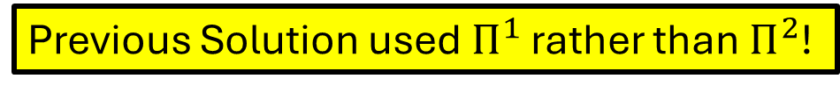

A Correction
Let’s go back to this example:
$$P=\left\{p^{1}∈ℝ^{m} \right| {(Π^{2})}^{T}p^{1}≤1, p^{1}≥0\}$$
20
Let $p^{1}=(x,y)$
30
-3
-6
-10
2
-20
$P$ is the polytope bounded by:
-10
4
20
-5
-4
$$−6x+4y ≤1$$
$$2x−5y≤1$$
$$−3x−4y ≤1$$
Previous Solution used $Π^{1}$ rather than $Π^{2}$!
$$x ≥0$$
$$y ≥0$$

Slide 6
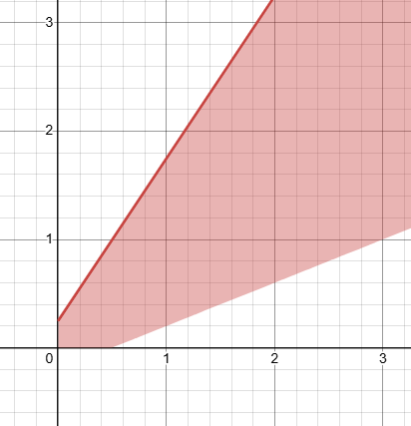


A Correction
$$y$$
The region formed by our expectation value constraints is unbounded in Quadrant I
Something is going wrong here…
$$x$$

Slide 7


Best Response Polytopes
$P=\left\{p^{1}∈ℝ^{m} \right| {(Π^{2})}^{T}p^{1}≤v1, p^{1}$ is a probability vector$\}$
$Q=\left\{p^{2}∈ℝ^{n} \right| Π^{1}p^{2}≤u1, { p}^{2}$ is a probability vector$\}$
I$f u$ and $v$ are positive
I$f u$ and $v$ are negative
$$P=\left\{p^{1}∈ℝ^{m} \right| {(Π^{2})}^{T}p^{1}≤1, p^{1}≥0\}$$
$$Q=\left\{p^{2}∈ℝ^{n} \right| Π^{1}p^{2}≤1, { p}^{2}≥0\}$$
$$P=\left\{p^{1}∈ℝ^{m} \right| {(Π^{2})}^{T}p^{1}≥1, p^{1}≤0\}$$
$$Q=\left\{p^{2}∈ℝ^{n} \right| Π^{1}p^{2}≥1, { p}^{2}≤0\}$$

Slide 8
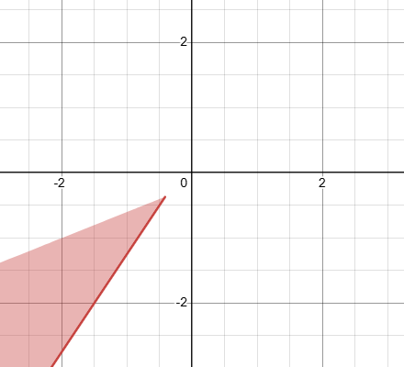







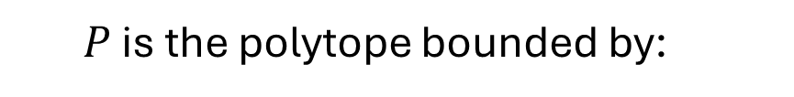

Combinatorial Vertex Enumeration
$$y$$
$P$ is the polytope bounded by:
$$−6x+4y ≥1$$
$$2x−5y≥1$$
$$−3x−4y ≥1$$
$$x$$
$$x ≤0$$
$$y ≤0$$
$$P$$

Slide 9



















Combinatorial Vertex Enumeration
Since our probability vector $p^{1}$ lives in $ℝ^{n}$, we select two constraints at a time to make strict and solve
$$−6x+4y=1$$
$$2x−5y=1$$
$P$ is the polytope bounded by:
$$2x−5y=1$$
$$x=0$$
$$−6x+4y=1$$
$$2x−5y=1$$
$$−6x+4y ≤1$$
$$−3x−4y=1$$
$$y=0$$
$$2x−5y≤1$$
$$−6x+4y=1$$
$$−3x−4y=1$$
$$−3x−4y ≤1$$
$$x=0$$
$$x=0$$
$$x ≥0$$
$$−6x+4y=1$$
$$−3x−4y=1$$
$$y ≥0$$
$$y=0$$
$$y=0$$
$$2x−5y=1$$
$$x=0$$
$$−3x−4y=1$$
$$y=0$$

Slide 10












Combinatorial Vertex Enumeration
Since our probability vector $p^{1}$ lives in $ℝ^{n}$, we select two constraints at a time to make strict and solve
$$x=−9/22$$
$$x=0$$
$$y=−4/11$$
$$y=−1/5$$
$P$ is the polytope bounded by:
$$x=−2/9$$
$$x=1/2$$
$$−6x+4y ≤1$$
$$y=−1/12$$
$$y=0$$
$$2x−5y≤1$$
$$x=0$$
$$x=0$$
$$−3x−4y ≤1$$
$$y=1/4$$
$$y=−1/4$$
$$x ≥0$$
$$x=−1/6$$
$$x=−1/3$$
$$y ≥0$$
$$y=0$$
$$y=0$$
$$x=−1/23$$
$$x=0$$
$$y=−5/23$$
$$y=0$$

Slide 11
Combinatorial Vertex Enumeration
Since our probability vector $p^{1}$ lives in $ℝ^{n}$, we select two constraints at a time to make strict and solve
$$x=−9/22$$
$$x=0$$
$$y=−4/11$$
$$y=−1/5$$
$P$ is the polytope bounded by:
$$x=−2/9$$
$$x=1/2$$
$$−6x+4y ≤1$$
$$y=−1/12$$
$$y=0$$
$$2x−5y≤1$$
$$x=0$$
$$x=0$$
$$−3x−4y ≤1$$
$$y=1/4$$
$$y=−1/4$$
$$x ≥0$$
$$x=−1/6$$
$$x=−1/3$$
$$y ≥0$$
These are the only points satisfying all constraints
$$y=0$$
$$y=0$$
$$x=−1/23$$
$$x=0$$
$$y=−5/23$$
$$y=0$$

Slide 12





















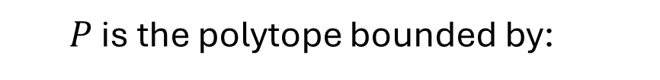




Combinatorial Vertex Enumeration
Since our probability vector $p^{1}$ lives in $ℝ^{n}$, we select two constraints at a time to make strict and solve
$$x=−9/22$$
$$x=0$$
$$y=−4/11$$
$$y=−1/5$$
$P$ is the polytope bounded by:
$$x=−2/9$$
$$x=1/2$$
$$−6x+4y ≤1$$
$$y=−1/12$$
$$y=0$$
$$2x−5y≤1$$
$$x=0$$
$$x=0$$
$$−3x−4y ≤1$$
$$y=1/4$$
$$y=−1/4$$
$$x ≥0$$
$$x=−1/6$$
$$x=−1/3$$
$$y ≥0$$
This means that Player 2’s maximum expected value occurs with the following strategy selections: 2 A, 1 B
$$y=0$$
$$y=0$$
$$x=−1/23$$
$$x=0$$
$$y=−5/23$$
$$y=0$$

Slide 13
A Correction
Let’s go back to this example:
This means that Player 2’s maximum expected value occurs with the following strategy selections: 2 A, 1 B
20
30
-3
-6
-10
2
-10
-20
4
20
-5
-4
But these are not equal!

Slide 14
Combinatorial Vertex Enumeration
Since our probability vector $p^{1}$ lives in $ℝ^{n}$, we select two constraints at a time to make strict and solve
$$x=−9/22$$
$$x=0$$
$$y=−4/11$$
$$y=−1/5$$
$P$ is the polytope bounded by:
$$x=−2/9$$
$$x=1/2$$
$$−6x+4y ≤1$$
$$y=−1/12$$
$$y=0$$
$$2x−5y≤1$$
$$x=0$$
$$x=0$$
$$−3x−4y ≤1$$
These constraints eliminate all of the “interesting” vertices
$$y=1/4$$
$$y=−1/4$$
$$x ≥0$$
$$x=−1/6$$
$$x=−1/3$$
$$y ≥0$$
$$y=0$$
$$y=0$$
$$x=−1/23$$
$$x=0$$
$$y=−5/23$$
$$y=0$$

Slide 15





Combinatorial Vertex Enumeration
Since our probability vector $p^{1}$ lives in $ℝ^{n}$, we select two constraints at a time to make strict and solve
$$x=−9/22$$
$$x=0$$
$$y=−4/11$$
$$y=−1/5$$
$P$ is the polytope bounded by:
$$x=−2/9$$
$$x=1/2$$
$$−6x+4y ≥1$$
$$y=−1/12$$
$$y=0$$
$$2x−5y≥1$$
We “flip the inequality” in each expression
$$x=0$$
$$x=0$$
$$−3x−4y ≥1$$
$$y=1/4$$
$$y=−1/4$$
$$x ≤0$$
$$x=−1/6$$
$$x=−1/3$$
$$y ≤0$$
$$y=0$$
$$y=0$$
$$x=−1/23$$
$$x=0$$
$$y=−5/23$$
$$y=0$$

Slide 16
Combinatorial Vertex Enumeration
Since our probability vector $p^{1}$ lives in $ℝ^{n}$, we select two constraints at a time to make strict and solve
$$x=−9/22$$
$$x=0$$
$$y=−4/11$$
$$y=−1/5$$
$P$ is the polytope bounded by:
$$x=−2/9$$
$$x=1/2$$
$$−6x+4y ≥1$$
$$y=−1/12$$
$$y=0$$
$$2x−5y≥1$$
This corresponds to our Nash equilibrium!
$$x=0$$
$$x=0$$
$$−3x−4y ≥1$$
$$y=1/4$$
$$y=−1/4$$
$$x ≤0$$
$$x=−1/6$$
$$x=−1/3$$
$$y ≤0$$
$$y=0$$
$$y=0$$
$$x=−1/23$$
$$x=0$$
$$y=−5/23$$
$$y=0$$

Slide 17
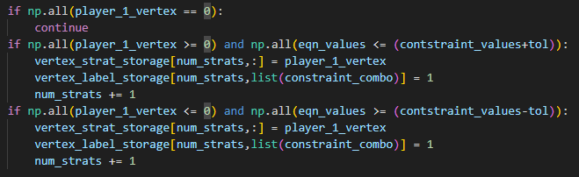
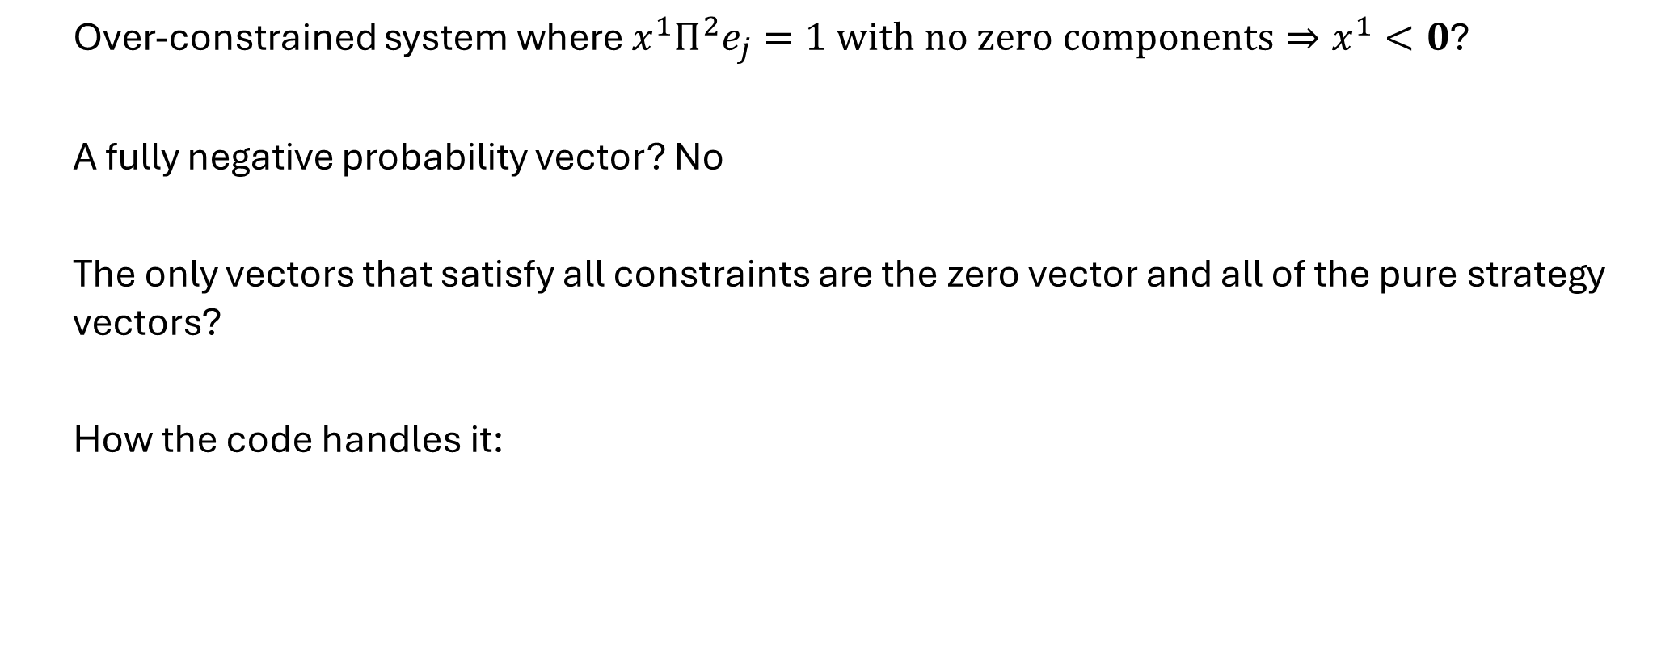
How Do We Know When a Player’s Maximum Expected Value is Negative?
Over-constrained system where $x^{1}Π^{2}e_{j}=1 with no zero components⇒x^{1}<0$?
A fully negative probability vector? No
The only vectors that satisfy all constraints are the zero vector and all of the pure strategy vectors?
How the code handles it:

Slide 18
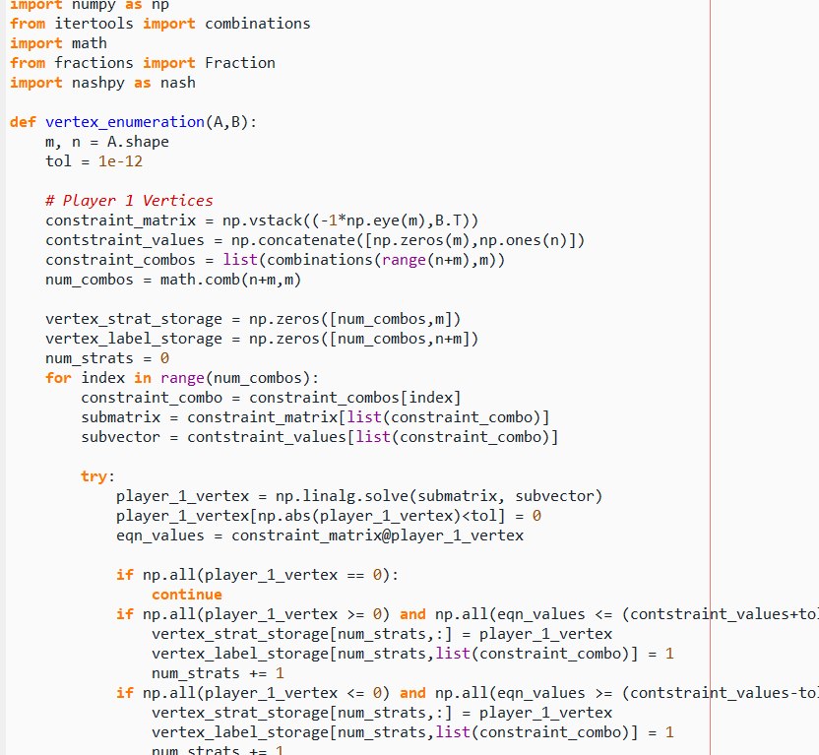
Combinatorial Vertex Enumeration Function
As a proof of concept, I coded up a combinatorial vertex enumeration program in Python
I’ve successfully tested it on the 2 x 3 example discussed and the three examples used for previous testing
The code is included in Appendix A of this week’s latex write up

Slide 19
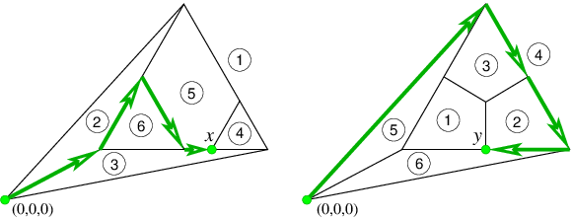
Simplex Algorithm and Nash Equilibrium
Is there a way to use the mechanics of the simplex algorithm to find Nash equilibrium?
This is the intuition behind the Lemke-Howson Algorithm

Slide 20
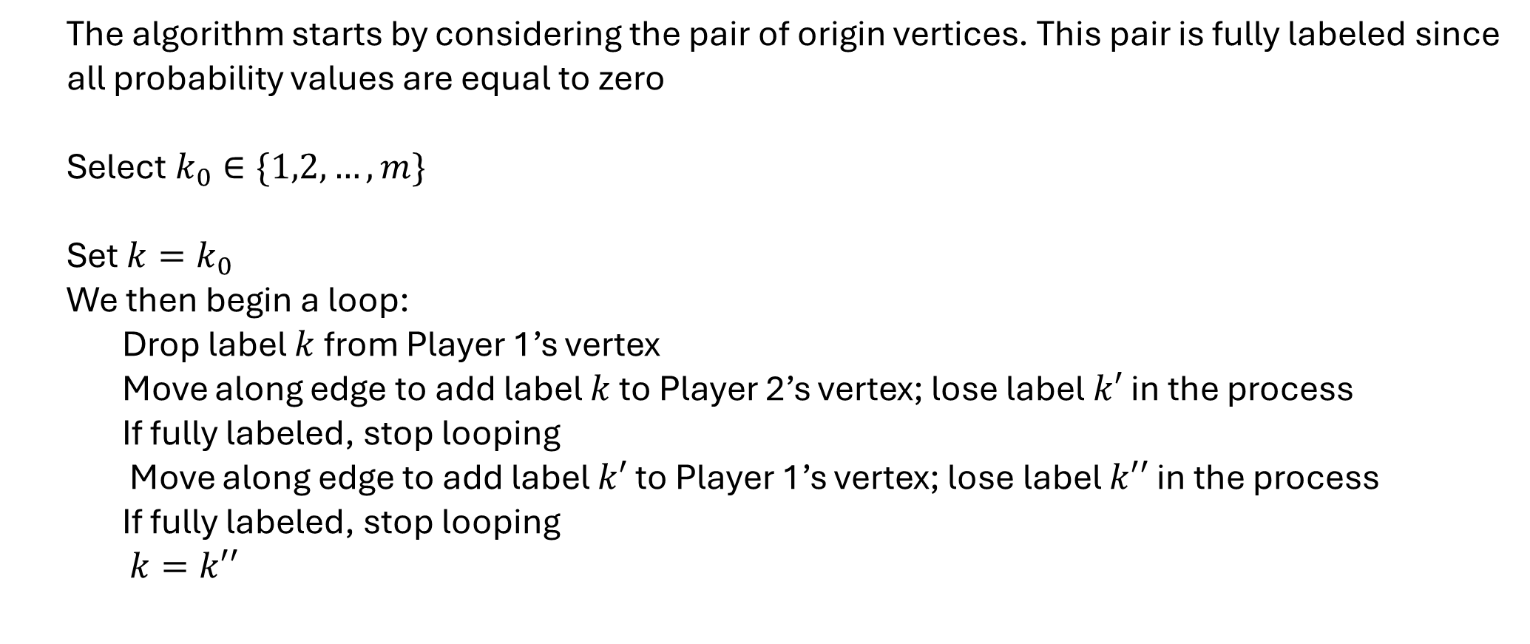
Lemke-Howson Algorithm
The algorithm starts by considering the pair of origin vertices. This pair is fully labeled since all probability values are equal to zero
Select $k_{0}∈\{1,2,…,m\}$
Set ${k=k}_{0}$
We then begin a loop:
Drop label $k$ from Player 1’s vertex
Move along edge to add label $k$ to Player 2’s vertex; lose label $k′$ in the process
If fully labeled, stop looping
Move along edge to add label $k′$ to Player 1’s vertex; lose label $k′′$ in the process
If fully labeled, stop looping
$k=k′′$

Slide 21



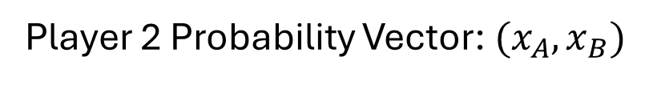

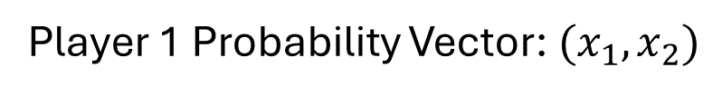




Lemke-Howson Algorithm
Example:
Player 1 Payoffs
Player 2 Payoffs
A
B
A
B
4 | 1
2 | 3
1 | 4
3 | 2
1
1
2
2
Player 1 Probability Vector: $(x_{1},x_{2})$
Player 2 Probability Vector: $(x_{A},x_{B})$
$$4x_{1}+2x_{2}≤1$$
$$1x_{A}+4x_{B}≤1$$
$$1x_{1}+3x_{2}≤1$$
$$3x_{A}+2x_{B}≤1$$
$$x_{1}≥0$$
$$x_{A}≥0$$
$$x_{2}≥0$$
$$x_{B}≥0$$

Slide 22
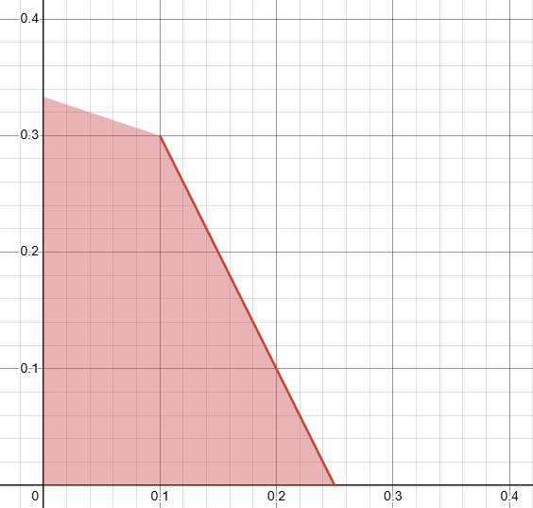
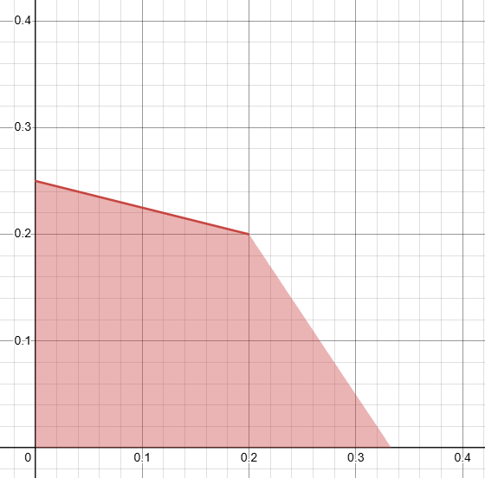




Lemke-Howson Algorithm
Example:
$$x_{2}$$
Player 1 Polytope
$$x_{B}$$
Player 2 Polytope
$$x_{1}$$
$$x_{A}$$

Slide 23
Lemke-Howson Algorithm
Example:
$$x_{2}$$
Player 1 Polytope
$$x_{B}$$
Player 2 Polytope
Start with the pair of origin vertices
1,2
A,B
$$x_{1}$$
$$x_{A}$$

Slide 24

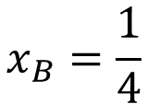
Lemke-Howson Algorithm
Example:
$$x_{2}$$
Player 1 Polytope
$$x_{B}$$
Player 2 Polytope
“Drop” Label 1 from Player 1 Polytope
Strategy 1 must have highest expected value
A,1
$$1x_{A}+4x_{B}=1$$
$$x_{B}=\frac{1}{4}$$
1,2
A,B
$$x_{1}$$
$$x_{A}$$

Slide 25

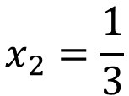
Lemke-Howson Algorithm
Example:
$$x_{2}$$
Player 1 Polytope
$$x_{B}$$
Player 2 Polytope
Strategy B must have highest expected value
1,B
A,1
$$1x_{1}+3x_{2}=1$$
$$x_{2}=\frac{1}{3}$$
1,2
$$x_{1}$$
$$x_{A}$$

Slide 26
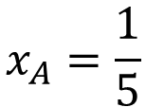
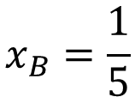

Lemke-Howson Algorithm
Example:
$$x_{2}$$
Player 1 Polytope
$$x_{B}$$
Player 2 Polytope
Strategy 2 must have highest expected value
1,B
A,1
$$3x_{A}+2x_{B}=1$$
1,2
$$x_{A}=\frac{1}{5}$$
$$x_{B}=\frac{1}{5}$$
$$x_{1}$$
$$x_{A}$$

Slide 27

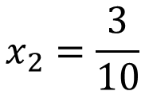
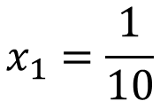
Lemke-Howson Algorithm
Example:
$$x_{2}$$
Player 1 Polytope
$$x_{B}$$
Player 2 Polytope
Strategy A must have highest expected value
1,B
A,B
$$4x_{1}+2x_{2}=1$$
$$x_{1}=\frac{1}{10}$$
1,2
$$x_{2}=\frac{3}{10}$$
$$x_{1}$$
$$x_{A}$$

Slide 28
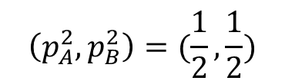
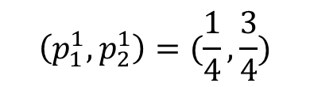
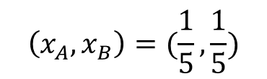
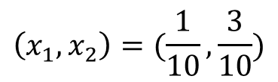
Lemke-Howson Algorithm
Example:
$$x_{2}$$
Player 1 Polytope
$$x_{B}$$
We stop because we are fully labeled
Player 2 Polytope
$$\left(x_{1},x_{2}\right)=(\frac{1}{10},\frac{3}{10})$$
A,B
$$\left(x_{A},x_{B}\right)=(\frac{1}{5},\frac{1}{5})$$
1,2
$$\left(p_{1}^{1},p_{2}^{1}\right)=(\frac{1}{4},\frac{3}{4})$$
$$\left(p_{A}^{2},p_{B}^{2}\right)=(\frac{1}{2},\frac{1}{2})$$
This is our Nash Equilibrium
$$x_{1}$$
$$x_{A}$$

Slide 29

Brown-von Neumann- Nash Dynamics
We use the set of continuous functions that Nash defined for his existence proof:
$$φ_{ij}\left(p\right)=max⁡(0, {Payoff}_{i}\left(e_{j}\right)−{Payoff}_{i}\left(p\right))$$
${Payoff}_{i}\left(e_{j}\right) −$ payoff to $i$th Player from playing pure strategy $j$
${Payoff}_{i}\left(p\right) −$ payoff to $i$th Player from playing strategy $p$
$φ_{ij}\left(p\right)−$ either $0$ or the value gained by switching to pure strategy $j$
We evolve each player’s probabilities according to the following ODE:
$${\dot{p}}_{ij}=φ_{ij}\left(p\right)−p_{ij}\sum_{k}{φ_{ik}\left(p\right)}$$
$p_{ij}\left(p\right)−$ the probability that player $i$ chooses strategy $j$

